Slide 1
Adidas Project Weekly Report
March 25, 2021
Jinhang Jiang

Slide 2
Review last week’s work
AWS - Collect data /1 hour (50+10) for 200 rounds
Case Study
Text analytics
Summary

Slide 3
What we have done
Node2vec & k-means on fanbase segmentation/clustering
Transition matrix, markov chain convergence, and cosine similarity on fanbase
Found a bug in generating adjacency matrix, fixed it

Slide 4
Case Study
8 Korean idols
Picked them based on stage style, fanbase characteristics, gender...
Their fans are very active on reddit
Purpose to verify the effectiveness of the model
Hypothesis: A&B are similar; A&C are very different

Slide 5
Case Study - Network Analysis
Black Pink: girl group, 2016, YG Entertainment, by Adidas
GFriend, girl group, 2015, Source Music
IZ*ONE, girl group, 2018, Produce48 by Mnet
Naeun Son, signer(Apink), 2011, Play M Entertainment, by Adidas
Seolhyun Kim, signer(AOA), 2012, FNC Entertainment, by Nike
Solar, singer(Mamamoo), 2014, RBW Entertainment
BTS, boy group, 2013, Big Hit Entertainment
NCT, boy group, 2016, SM Town, by NBA Style Korea

Slide 6
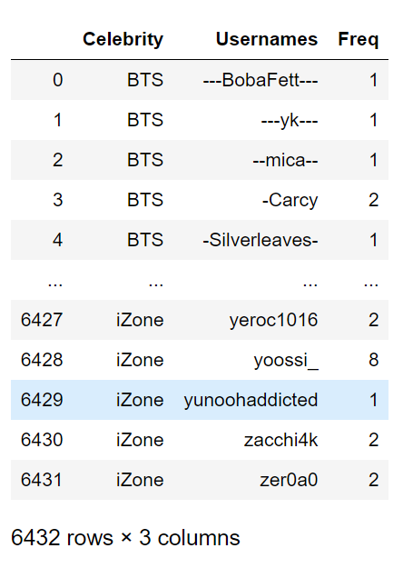
Case Study - Network Analysis

Slide 7
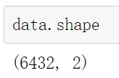
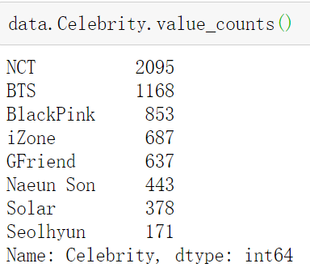
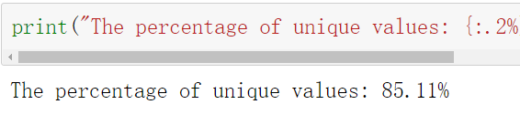
Case Study - Network Analysis

Slide 8
Case Study - Network Analysis
Hypothesis:
BlackPink could be dissimilar from the other two girl groups based on their stage style (cool vs. cute)
NCT and BTS will be dissimilar from each other since boy groups’ fans are very sensitive to other idols
Naeun Son, Seolhyun, and Solar should be similar to each other based on their stage style (positive and athletic)

Slide 9
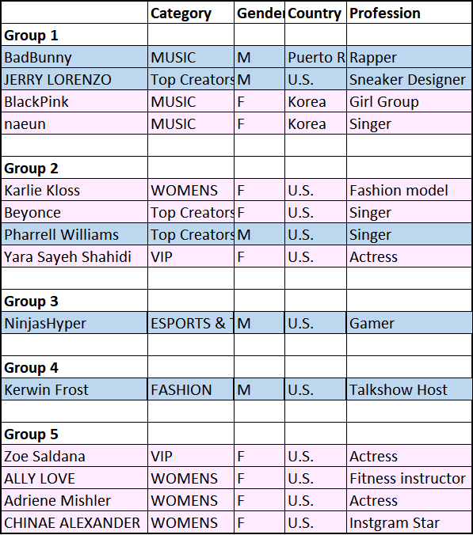
Case Study - Network Analysis

Slide 10
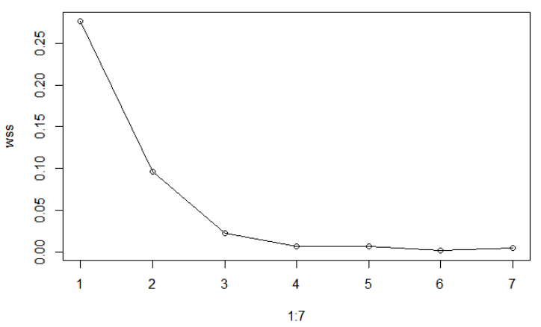
Case Study - Network Analysis

Slide 11
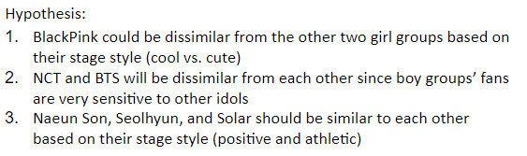
Case Study - Network Analysis
Group 1: BTS, NCT, BlackPink, Solar
Group 2: Seolhyun, Naeun Son
Group 3: GFriend, iZone

Slide 12
Case Study - Network Analysis
Group 1: Solar, BTS
Group 2: Seolhyun, Naeun Son
Group 3: GFriend, iZone
Group 4: BlackPink, NCT

Slide 13
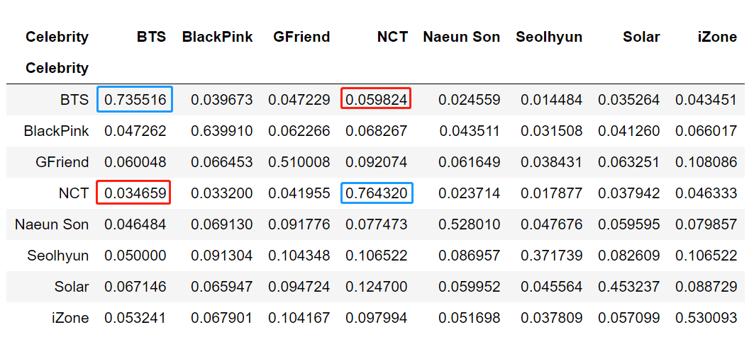
Case Study - Similarity Analysis

Slide 14
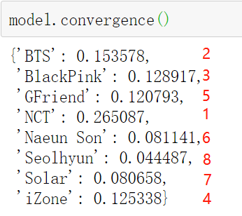
Case Study - Similarity Analysis
32.57%

Slide 15
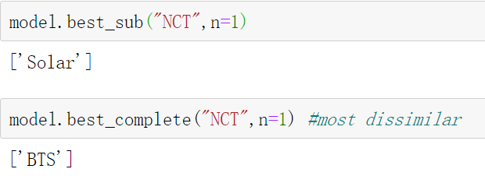
Case Study - Similarity Analysis

Slide 16
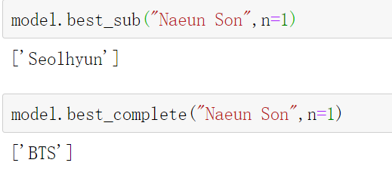
Case Study - Similarity Analysis

Slide 17
Case Study
Summary:
Our second hypothesis (Male celebrities’ fanbase is very unique) was proven multiple times under different conditions.
Similarity vs. Network Analysis return slightly different results, but from the high level, they are telling us the same story
The similarity analysis (including Markov chain and cosine) is very sensitive to the data quality (our data is extremely biased regarding the size of fanbase)

Slide 18
Text Analysis
Performed k-means, cosine_similarity with TF-IDF
Data quality is poor:
Korean presented
A lot of web link presented (instagram)
Old data contains 6200+ observations for 10 celebrities (on the list)
Rewrote the code, and took 13 hours to complete for 8 Korean idols
Plan to do word2vec

Slide 19
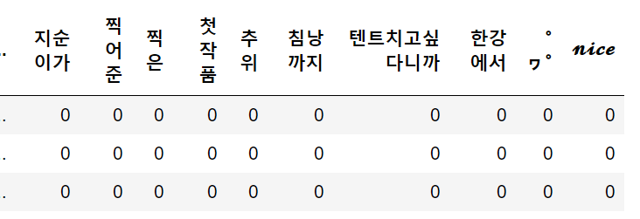
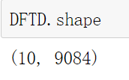
Text Analysis - TFIDF
10 celebrities (since data collected from subreddits)
Some of them only have a few comments (e.g. Adriene Mishler)

Slide 20
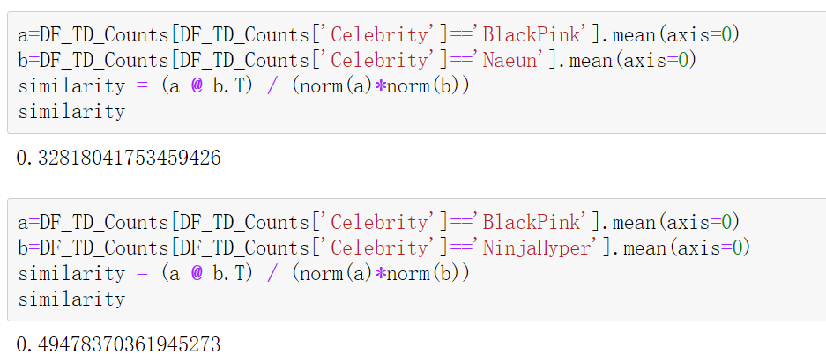
Text Analysis - TFIDF&Cosine

Slide 21
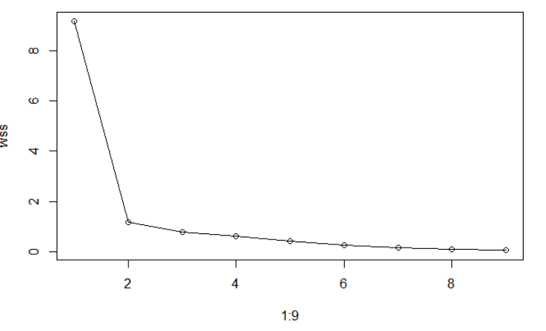
Text Analysis - TFIDF&K-means

Slide 22
Text Analysis - TFIDF&K-means
When k = 2:
Group 1: Naeun
Rest of them
When k = 4:
Group 1: Naeun
Group 2: NinjiaHyper
Group 3: Bad Bunny
Group 4: Rest of them

Slide 23
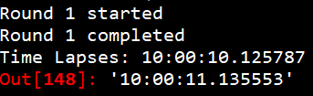
Text Analysis
Rewrote the code:
Use keywords instead of subreddits
for i in all.search(j, limit=None):
i.comments.replace_more(limit=10)
Not very efficient, 10 hours for 6 celebrities (404 error on 7th)

Slide 24
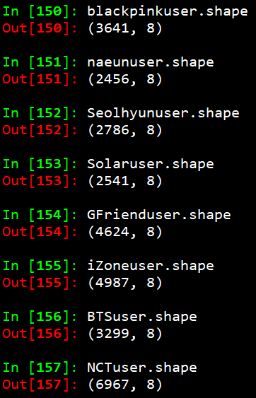
Text Analysis - New data
New data has 31301 observations

Slide 25
Summary
AWS - while function to collect streaming data
Case study
Text analysis with TFIDF
Redo TFIDF with new data
Word2vec

